Slide 1
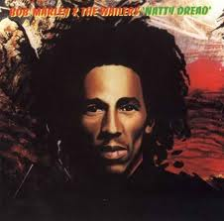
Finance and the Future
In this great future you can’t forget your past …
by David Pollard

Slide 2
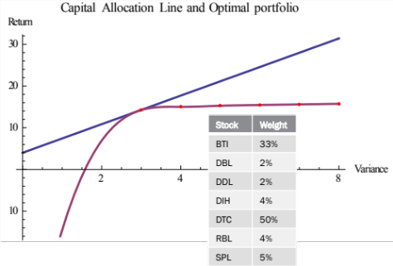
Financial forecasting
Many reasons for forecasting financial data
  Speculative trading
    Punters
      Speculators who work on instinct apparently without a systematic method
  Risk management
    Forecasting downside scenarios & probabilities
  Asset allocation
    Modern Portfolio Theory
      Forecasts of asset prices & volatility
      Construction of diversified portfolios

Slide 3
What price in 6 months time?

Slide 4
… And the answer is!
70
You can even use Astrology for your predictions but what if you want to use Maths …?
Notes:
Comment aside about Prof. Kibble’s (Higgs-Kibble Boson) ideas on theory selection: “What works!”

Slide 5
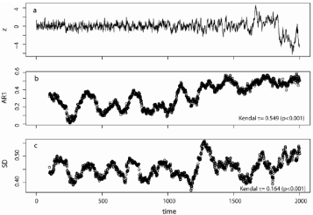
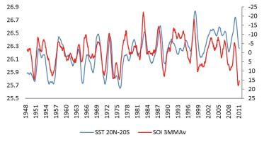
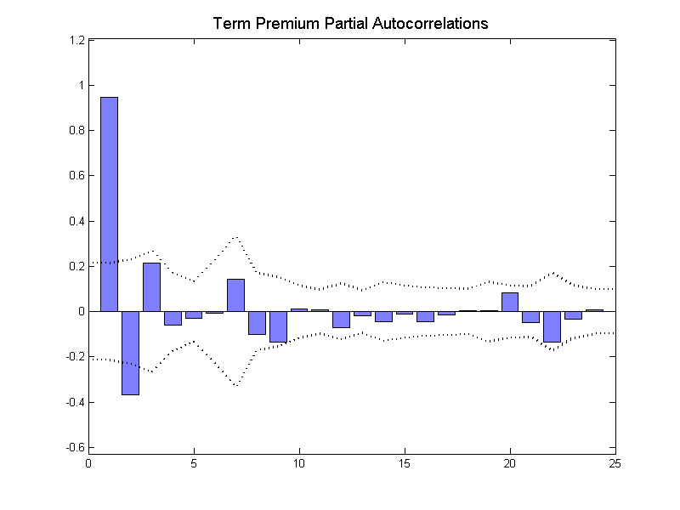

AR model
MA model
Moving Average
Auto Regressive
Time Series Modeling
GARCH
ARMA
Generalised Auto Regressive Conditional Heteroscedasticity!

Slide 6
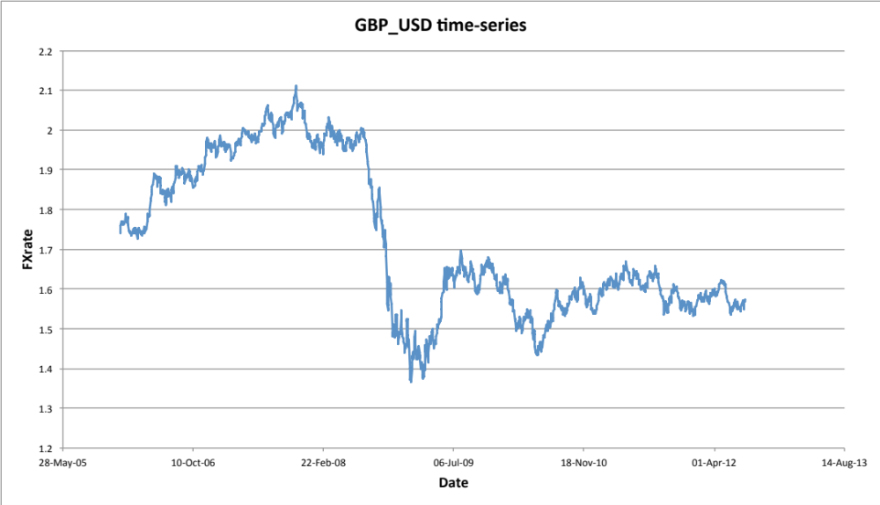
History = time series
  Price vs. Time or FX Rate vs. Time graph
  Benchmark
    Daily, closing price / rate data
  Look out for
    Other periodicity e.g. GASCI data are weekly
    Regularity
      E.g. TTSE changed from thrice weekly to daily in 2008
  Practical point
    Data storage in Databases
    Beyond Excel spreadsheets

Slide 7
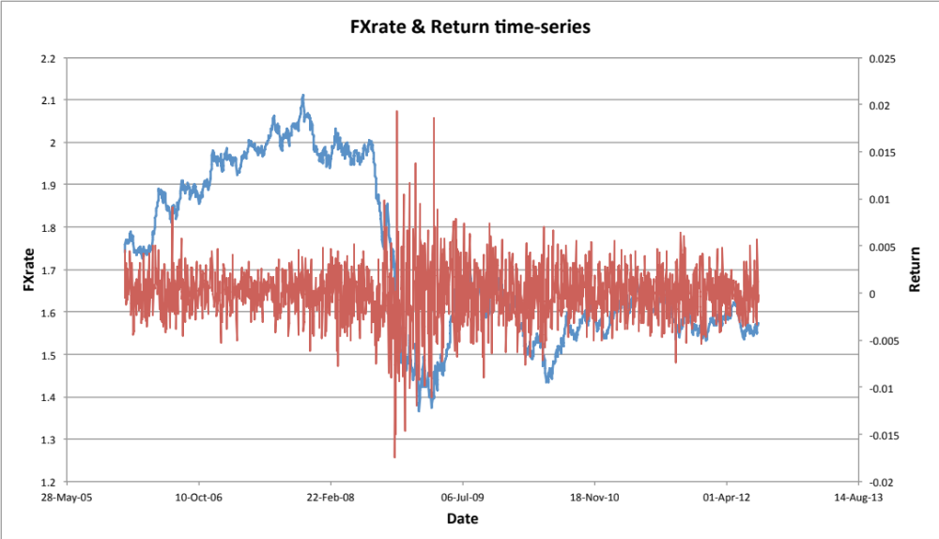
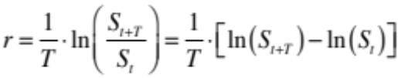
What's predictable?
  Ultimately we want to forecast prices
    … and volatilities
  Should we work with the price time-series directly?
  No!
    Statistics not usually ‘stationary’
  Consider price returns instead
    Statistics more likely to be stationary (and so tractable)
    Recall that price returns

Slide 8


Time series models
Univariate
only!
  Time series models can produce sequences that ‘look like’ return graphs
  General form
  f is a function of prior values of the observed return
    Previsible
  Function can also depend on other variables e.g. prior volatilities …
    More about volatilities later
  Error term often assumed to be Normally Distributed with zero mean
Function we can model
Return at time t
Error / noise term
The Bell Curve

Slide 9
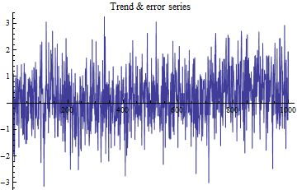

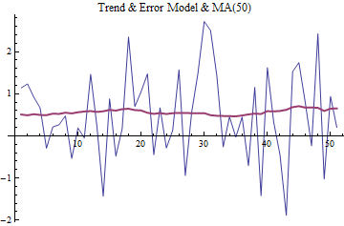
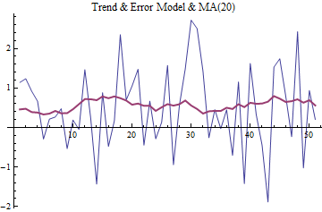
Moving averages
  MA series is the weighted sum of (prior) returns from some other series
  Effectively it ‘smooths’ the other series
  MA can be a filter of the other series
    With appropriate weights w
  Let other series simply be prior errors
    MA(p)

Slide 10

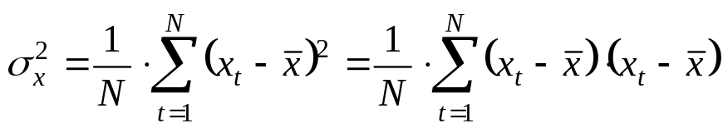
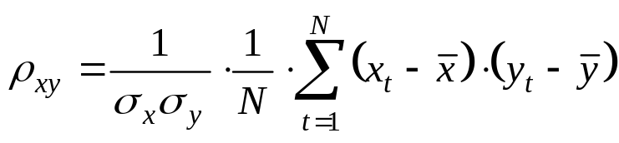
correlation
Variance is volatility (σ) squared
It measures average, squared deviations from the mean
The correlation coefficient is given by
The Correlation of an asset with itself = 1
Measures the extent to which deviations in 2 series match each other

Slide 11
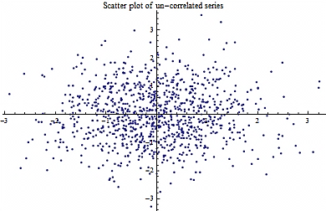
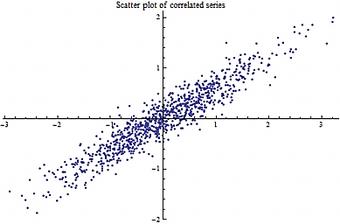
Correlation - visually
Un-correlated series
Correlated series

Slide 12
Autoregression
What if we looked at the correlation between one time-series and a second one that was simply a time shift of the first?
Auto-correlation!
Auto-Correlation function (ACF)
    Correlation of X with X-1 is 1st auto-correlation coefficient
    Correlation of X with X-2 is 2nd auto-correlation coefficient …
  If auto-correlation is “significant” the series is said to be Autoregressive
X
X-1
time
X-2

Slide 13
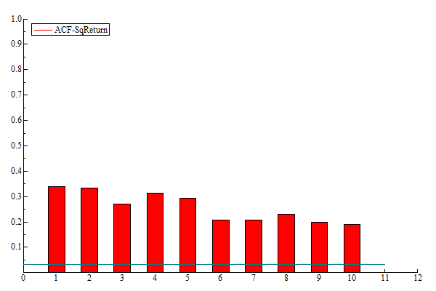
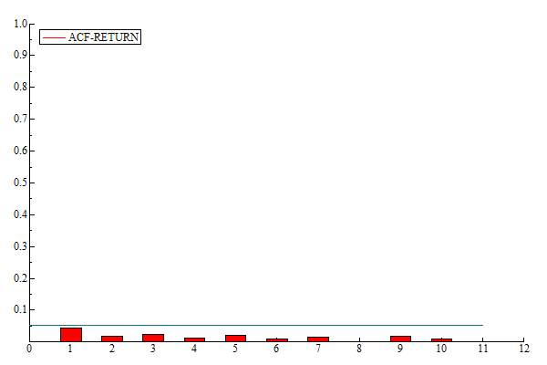
Auto Correlation Functions
Nasdaq: ACF
UCL: ACF
“The future ain’t what is used to be”
Yogi Berra
If X is correlated with X+1 then our “history” (X) tells us about our “future” (X+1)

Slide 14



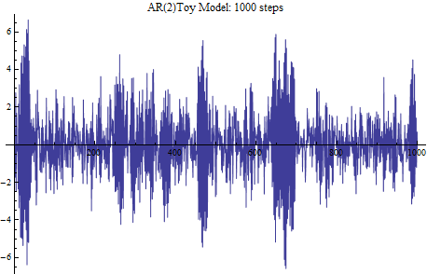
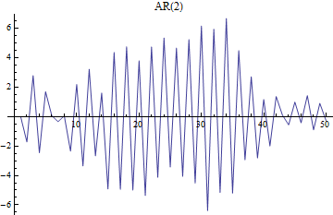
AR Models
  Time series equation for an Autoregressive process AR(q)
  AR(1) example
  AR(2) example (graphed below)
Clustering
Reversion
Notes:
Explain how both t-1 and t-2 terms contribute to reversion. Comment about restrictions on a1, a2 for boundedness

Slide 15
ARMA models
  Auto Regressive + Moving Average = ARMA
  So ARMA(p,q) model equation
  Will see a real life example in the case study that follows
Auto regressive part
Moving average part
Noise

Slide 16
maths vs. man - wco case study
  West Indian Tobacco Company (WCO)
    Trinidadian equivalent of Demerara Tobacco Company (DTC)
  Procedure
    Compute and analyse daily returns
    Compute Auto Correlation Function (ACF / PACF)
      Evidence of Auto Regressive behaviour?
    Choose an ARMA specification
    Fit the model
      only keep statistically significant terms
    Use (computer) simulation to produce a Forecast Fan

Slide 17
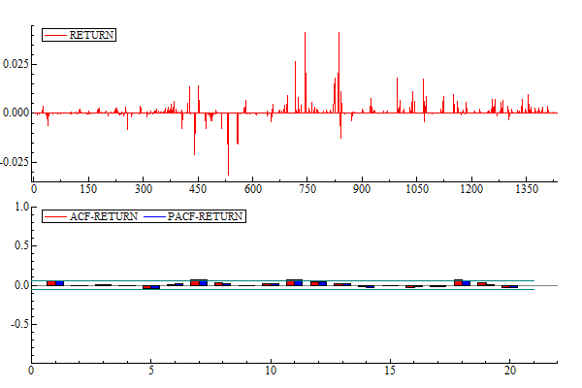
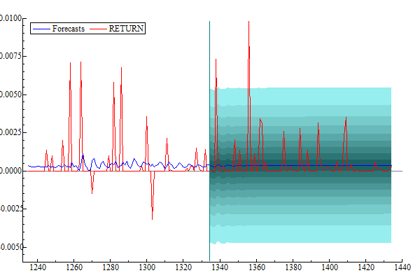
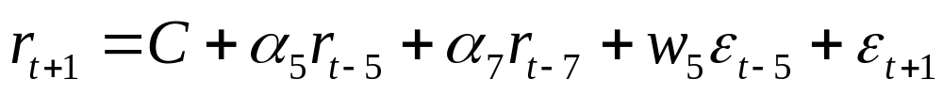
WCO: time series fit
Big returns during GFC!
Some auto-correlation?
Return forecast mostly flat

Slide 18
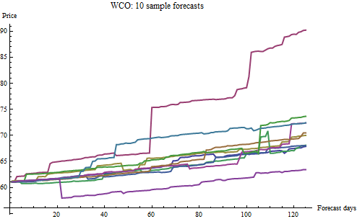
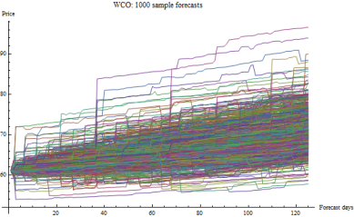
WCO: building a forecast
Find paths of Median, Upper Decile (0.9) and
Lower Decile (0.1)

Slide 19
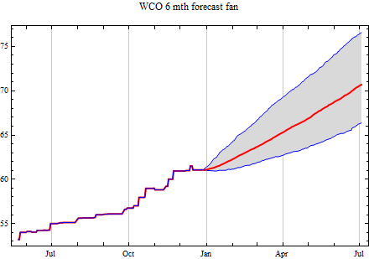
WCO: 6 month forecast
Median forecast 70.7
Actual 70.1

Slide 20
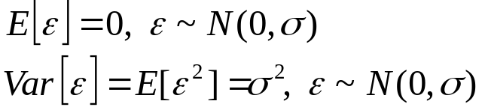
What about the Volatility?
  Expectation
    Taking Expectation is equivalent to averaging
    Variance is Expectation of squared deviations
  Conditional Expectation
    In a time series context
      what we know changes as time evolves
      What is left as random (the error / noise term) also evolves …
      … so how we compute averages (expectations) also evolves in time

Slide 21
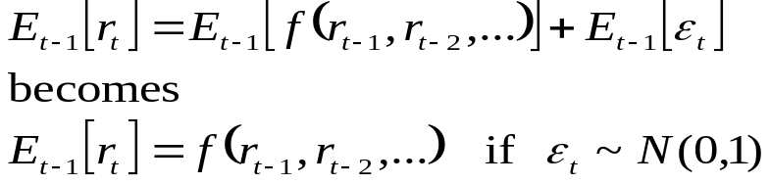
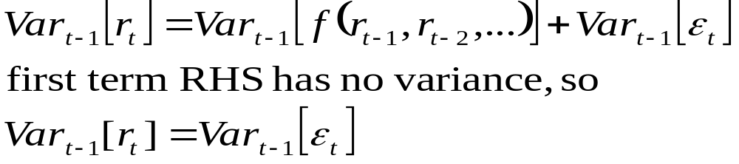
Time series variance
  Consider our time series model equations
  Then the conditional expectation of ‘one step ahead’ returns
  Which is what we used when forecasting
  Similarly for conditional variance we have
Conditional variance of returns is determined by the noise / error term
Notes:
Remind audience that variance is volatility squared

Slide 22
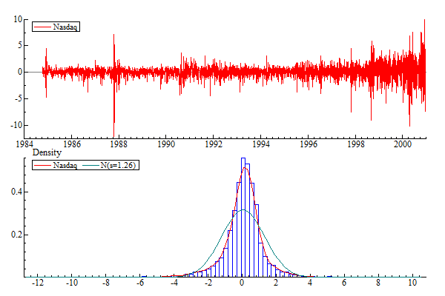
financial Volatility: nasdaq
Heteroscedasticity
Clustering
Non-normal Noise

Slide 23
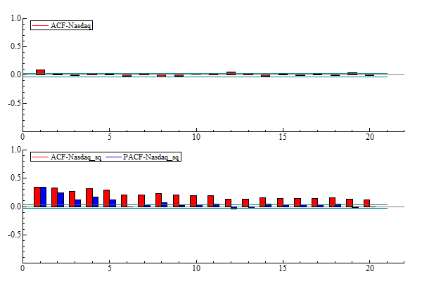
Volatility & return acfs
Returns
Squared returns
Partial ACF

Slide 24


GARCH!
  Generalised Auto-Regressive Conditional Heteroscedasticity
  Insight
    Introduce an explicit volatility multiplier for the error / noise term
    That (conditional) volatility will need to be heteroscedastic
      reflecting observed, empirical features
    Use an auto-regressive time series model for the conditional variance
  GARCH
    Recall our time series model
    Instead now use
Economics Nobel Prize
2003
Robert Engle

Slide 25
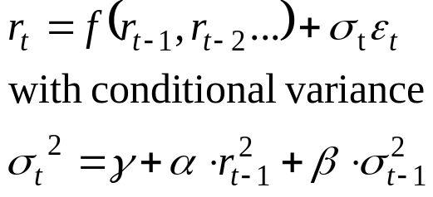
GARCH: variance equation
Regression on squared returns
Auto-regression on previous conditional variance
So for GARCH(1,1)
For GARCH(p,q) the variance equation generalises

Slide 26
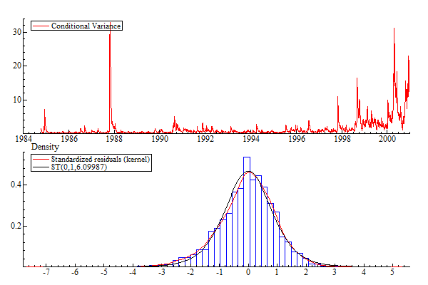
Nasdaq: garch variance
ARMA(1,1) – mean
GARCH(1,1) - variance
Student’s t – Noise
Monday’s are special
Crisis | Date
Black Monday | Oct 1987
Asian Crisis | Oct 1997
LTCM/Russian Crisis | Aug 1998
Dot-com Bubble | Apr 2000
VIX is the “fear gauge”

Slide 27
A pause for breath
Let us review the path taken
Moving Average (MA) models
    Smooth randomness revealing trend
Autoregressive (AR) models
    Capture statistical relations between current and recent history
Autoregressive Moving Average (ARMA) models
    Combine AR and MA features
    Can produce convincing forecasts
Generalisd Autoregressive Conditional Heteroscedasticity (GARCH) models
    Include volatility modelling
    Widely accepted volatility forecasting capabilities

Slide 28
Quiz
Which time-series model uses the longest ‘history’?
A) ARMA(1,2)
B) GARCH(2,2)
C) MA(2)
D) AR(3)

Slide 29
Quiz
Which one of the following is not true of the Auto Correlation Function?
A) Its value is always 1
B) Its value is always between -1 and +1
C) A value above (or below) the level of significance indicates auto-regression
D) It is an important tool in the analysis of time series data

Slide 30
Quiz
In time series modeling what does the acronym GARCH mean?
A) Growing auto regression for controlling homogeneity
B) Growing and regressing classical homeothapy
C) Generalised auto regression conditioned with heteroscedasticity
D) Generalised auto regressive conditional heteroscedasticity

Slide 31
Close
  “Prediction is very difficult, especially about the future”
  Neils Bohr, Physicist
  Mathematical forecasting uses statistics to find links between past and future then builds models that capture those links
  The approach can be startlingly successful at times despite the fundamental impossibility of what is being attempted
Next week :
“Finance for the Future”

Slide 32
Tools
Books
    “Time Series Analysis”, James Hamilton, 1994
    “Time Series Models”, Andrew Harvey, 1993
    “Econometric Analysis”, William H. Greene, 7th Ed., 2011
Software
    R (www.r-project.org)
    OxMetrics (www.oxmetrics.net)
    Mathematica (www.wolfram.com/mathematica)
    MatLab (www.mathworks.com)

Slide 33
End

