Slide 1
Finance for the Future
The Product playbook
by David Pollard
Notes:
Financial products and services that will be useful in Guyana’s future

Slide 2
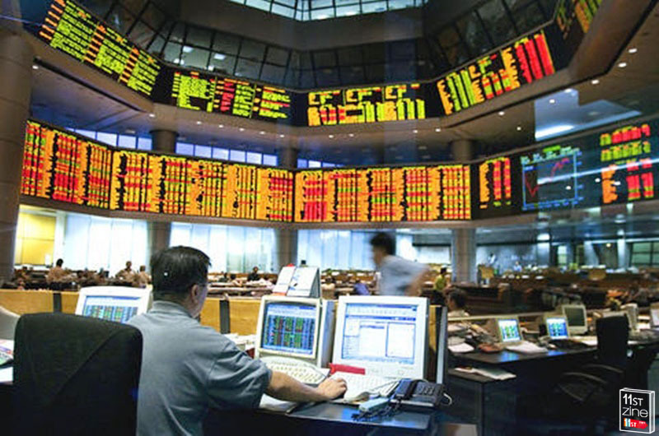
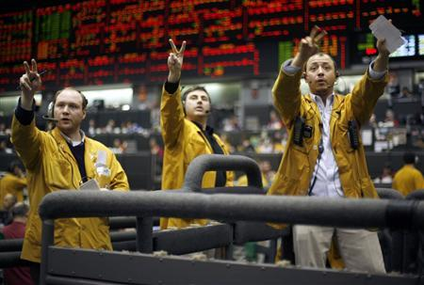
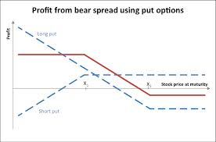
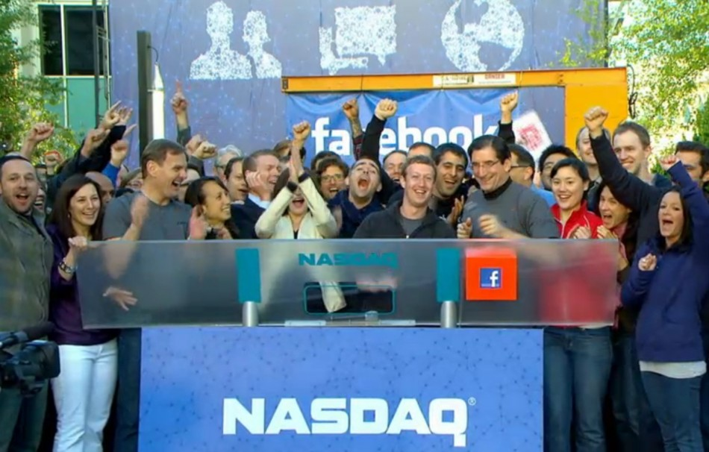
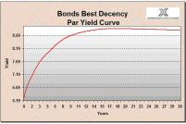

Forwards &
Futures
Trading
CME
Bursa Malaysia
New
Money
Options
Facebook IPO
Notes:
Not going to say much about IPOs.
Have already have something similar on the GASCI by CGX … panel discussion?

Slide 3
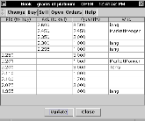

Paper based TradE
Buy
Exchange
Sell
Buy
$
Sell
CLIENT CA
BROKER A
BROKER B
CLIENT CB
Transfer form
Shares
Bad because
  Missed Dividends
  Increased Risk
Company
Registrar

Slide 4
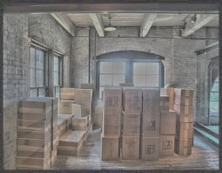
CENtral depository
Buy
Exchange
Sell
Buy
Sell
CLIENT CA
BROKER A
BROKER B
CLIENT CB
I buy for CA
I sell for CB
A
$
B
Good because
  Fast & efficient
  Secure
CA
CB
Central
Depository

Slide 5
Hedging 101: FRAs
  Mr Ragnauth’s rice sale problem
    He agreed sale of rice to Trinidadian customer for TTD 1M in 6 months time
    Needs money in GYD but how much will he get?
    Can he fix the TTD/GYD exchange rate NOW for his upcoming transaction in SIX MONTHS time and at what rate?
    Yes he can!
      Do a six month Forward Rate Agreement (FRA) for the TTD/GYD rate
    How can his favourite Cambio trader arrange this FRA for him?
      Use ARBITRAGE in a Forward Rate Trade …
        Not by FORECASTING!

Slide 6
TTD / GYD risk

Slide 7
The forward rate trade
GYD
6m deposit rate 1.8%
$30,067,581
3) Deposit GYD for 6m at 1.8%
$30,338, 189
2) Convert TTD loan to GYD at ‘spot’ FX rate
‘Spot’ TTD/GYD: 31.2327
‘Fwd’ TTD/GYD: 30.3382
Six months
$962,696
1) Borrow an amount at 7.75% to owe TTD $1M in 6m
TTD $1M
TTD
6m loan rate 7.75%
Completion
  Trinidadian client’s $1M repays the TTD loan
  Mr Ragnauth gets the GYD $30.3M
  Effective TTD/GYD rate of 30.3382
  Trader gets nothing!
    But has delivered his agreed forward rate

Slide 8

Hedging 101: FutureS
  Mrs Williams’ gold price problem
    Her husband mines gold near Port Kaituma and she does the finances
    Their new concession is producing beyond expectations
      Husband expects to come out with 300 oz. in December!
    Current gold price of USD $1,660 is good but what if it falls?
    Solution
      Hedge your exposure by ‘shorting’ 3 Gold Futures contracts
      Gold Futures trade on the Chicago Mercantile Exchange (CME)

Slide 9
FUTURES contracts
  Futures contracts (‘Futures’) are like FRAs but …
    Trade on Exchanges
      Very little counterparty risk
      Transparent pricing and trading
    Standardised specifications, for example
      Gold contract is for 100 oz.
      Price quote is in USD per oz.
      Standard delivery months: Dec, Feb, Apr, Jun …
    Trade on Margin
  Margin trading
    Customer posts initial margin
    Receives or pays margin daily as position moves for or against you

Slide 10
The futures trade
  Mrs Williams wants USD $1,660 x 300 oz. = USD $498,000 in December
  Posts initial Margin and ‘goes short’ 3 Dec Gold Futures at $1,660
    Being ‘short’ means you have negative exposure!
  Mrs Williams only gets USD $1,325 x 300 oz. = $397,500 from sale
Day | Price | Price Change | Margin
1-Nov | $1,600 | -$60 | +$18,000
25-Nov | $1,300 | -$300 | +$90,000
27-Dec | $1,325 | +$25 | -$7,500
Total |  |  | $100,500
Net result
  $397,500 from sale to Gold Board
  $100,500 from Gold Futures hedge!
  Total: $498,000 as required!
Notes:
Only know of 1 businessman in Guyana using futures and not quite doing it correctly!

Slide 11
Hedging cuts both ways
  Consider a different price scenario
  Mrs Williams is again ‘short’ 3 Dec Gold Futures at $1,660
  Now Mrs Williams gets USD $2,025 x 300 oz. = $607,500 from sale
Day | Price | Price Change | Margin
1-Nov | $1,700 | +$40 | -$12,000
25-Nov | $1,900 | +$200 | -$60,000
27-Dec | $2,025 | +$125 | -$37,500
Total |  |  | -$109,500
That’s what a hedge should do!
Net result now …
  $607,500 from sale to Gold Board
  -$109,500 from Gold Futures hedge
  Total: $498,000 again!
‘Hedging’ without upside loss requires Options

Slide 12
Going Short
  Buying and holding a stock is called ‘going long’
    Appropriate if you think stock price will rise
  What if you think a certain stock’s price will fall?
    You don’t own it
      good since you think it’s going to fall
    Can you benefit from your downwards price forecast?
  Yes you can!
    Go short the stock
      … even though you don’t own it!

Slide 13
The Short Trade
You feel sure XYZ’s price will fall within 6 months
Repurchase agreement
$100
YOU
LONG TERM
XYZ INVESTOR
XYZ Shares
1) ‘Buy’ XYZ from long term investor @ $100 agreeing that she will buy them back in 6m @ $95
$100
TRADER B
2) Sell the XYZ @ $100 in the market
Your net position
  XYZ shares: 0
  Money: $0

Slide 14

If You are right…
XYZ’s price falls to $50
$95
YOU
LONG TERM
XYZ INVESTOR
XYZ Shares
$50
1) Buy back XYZ @ $50 in the market so available for …
2) Long term investor repurchases XYZ @ $95
TRADER C
Your net position
  XYZ shares: 0
  Money: $45 ($95 -$50)

Slide 15
If You are wrong …
XYZ’s price rises to $150
$95
YOU
LONG TERM
XYZ INVESTOR
XYZ Shares
$150
1) You have to buy XYZ @ $150 in the market for …
2) Long term investor repurchases XYZ @ $95
TRADER C
Your net position
  XYZ shares: 0
  Money: -$55 (-$150 + $95)
‘Short Selling’ underpins Put Option writing

Slide 16
Bonds
  A loan to investors secured on a promise to repay interest at an agreed rate on the principal at regular intervals until the maturity of the loan at which time the principal is also repaid
    The regular interest payments are called coupon payments
    Creditworthiness of the issuer determines the coupon interest rate
    Consider a plain, vanilla bond
coupon
coupon period
Maturity
Bonds are a popular form of funding for …
  Governments and Government projects
    E.g. Berbice Harbour Bridge
  Corporates
  Municipalities
principal

Slide 17
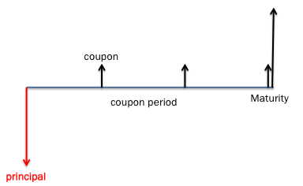

Bond Maths: Price
  Full Price = Flat Price + Accrued Interest
    Full Price is economic value of the bond
    Flat Price is the market traded price
    Accrued Interest is the coupon fraction owing on trade settlement date
  Full Price = Net Present Value (NPV) of the bond’s cash flows
    Recall that NPV of cash flow C at time T is
    For our 3 year bond example above:

Slide 18
Bond Maths: Price to yield
  What discounting rate r should we use in the price equation?
  Well ..
    The Flat price is known from the market
    The Accrued Interest can be calculated from
      coupon level
      days since last coupon
  Solve the Full Price Equation to find discount rate r that matches the price
    It is a transcendental equation so no tractable analytical solution
    Needs numerical equation solver
      e.g. Newton-Raphson method or Brent algorithm
  The discount rate that satisfies the price equation is called the Yield
    It is the Internal Rate of Return of the Bond

Slide 19
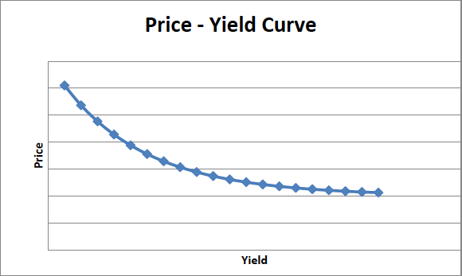

Bond Maths: yields
  Bonds usually trade on Yield rather than Price
    Prices are affected by coupon size effects
  Market quoted yield depends on …
    Daycount conventions
    Yield discount conventions
  Prices Up, Yields Down!
    Higher yield means heavier discounting hence lower price
  The graph of yield vs. maturity for bonds with the same credit has a coherent shape
    The Yield Curve
    … but many distortions of sovereign curves since GFC
  A bond’s yield is a measure of creditworthiness
    For a given Issuer …
    and given bond maturity
Euro crisis and
7% trigger level for
10 year yields
Notes:
Explain rising yield curve and expectation hypothesis

Slide 20
summary
  There is an exciting pipeline of financial innovation and new products for Financial Services in Guyana
  A key catalyst will be GASCI’s move from paper based to Central Depository based trading
  New products and innovations can help the Financial Services sector deliver new value to local businesses

