Slide 1
Maths & Money
A story of modern Finance
Let’s start at the very beginning …
by David Pollard
Notes:
A story of modern finance

Slide 2

Let’s start at the very beginning,
A very good place to start.
When you read you begin with A, B, C,
When you Quant you begin with Black-Scholes Theory!

Slide 3
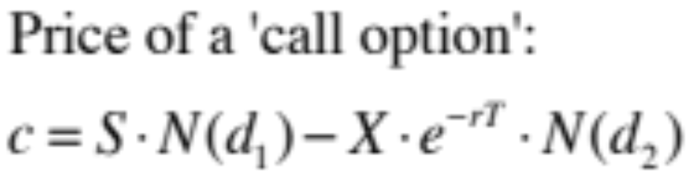
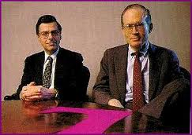
Black & Scholes Theory!
Fischer Black
Partner at Goldman Sachs - most (in)famous investment bank?
The Quants’ Quant – a legend
Myron Scholes
Nobel prize winner in Economics with Merton in 1997
Partner at Long Term Capital Management in 1998
‘When Genius failed’ (the first time!)
Let’s understand this
Notes:
Fischer Black died in 1995 and so was ineligible for Nobel prize
Will understand this formula by the end of the talk

Slide 4
The guide slide
Future Value, Present Value and Discounting
Arbitrage
Expected Return
Stocks & Shares and Options
Evolution of stock prices and the stock price process
Physicists in Finance
Philosophy!

Slide 5

FUTURE Value Question
Question: What is better, a dollar now or a dollar in one year’s time?
Don’t worry about theft etc.!
In fact we always assume Integrity in financial calculations
“No criminals” in Regulated financial markets

Slide 6
FUTURE Value answer
Answer: A dollar now because it can be invested to earn a return
Becomes more than a dollar in a year’s time
If nominal interest rates are positive
        as they usually are
Real interest rates are another matter entirely!
        Real rate = Nominal rate – rate of Inflation

Slide 7
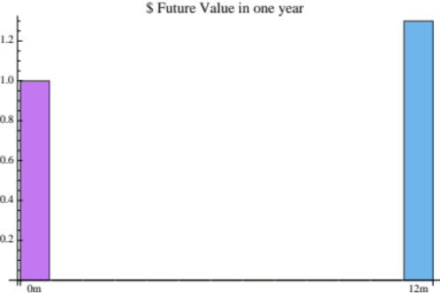

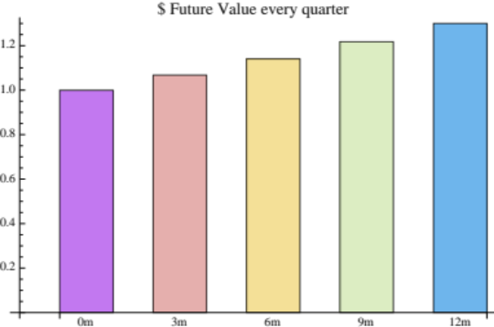

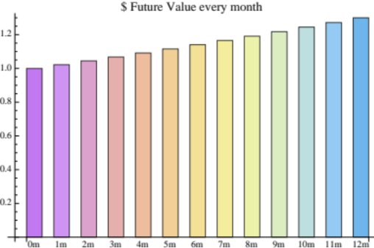

Future Value
If r=10% = 0.1
Future Value is 1.(1+0.1) = $1.10c
Compounding period

Slide 8
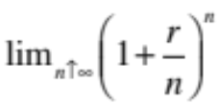
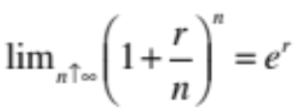
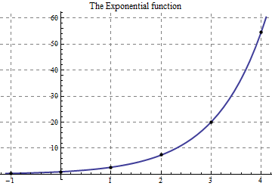


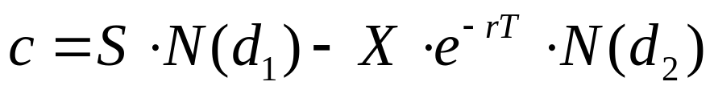
FUTURE Value – The formula
As compounding period gets smaller and smaller the Future Value factor in one year becomes ...
But, in the limit of continuous compounding, this is the mathematical definition of the Exponential Function
So future value of a dollar is
Conversely the Present Value today of a dollar in T year’s time
is the exponential with negative argument …
Discounting

Slide 9
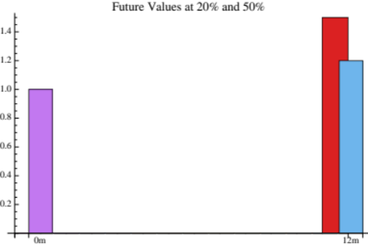
Arbitrage
Different interest rates present an ‘arbitrage’ opportunity
Bank A quotes 20% one year rate
Bank B quotes 50% one year rate
The arbitrage trade
Borrow $1M from Bank A at 20% and immediately lend it to Bank B at 50%
Riskless profit after 1 year: $1.5M - $1.2M = $300,000!
Interest rates must be the same unless they represent different levels of risk
There is only one ‘risk-free’ rate
All discounting is done at the (unique) risk free rate
Risk neutral valuation
  Black and Scholes used these arbitrage arguments to determine the value of r in

Slide 10

Expected return
Opportunity came to my door,
When I was down on my luck
In the shape of an old friend,
With a plan guaranteed
Have $1,000,000 to invest and two options;
Put it on the bank where, with 30% returns, it becomes $1,300,000 in a year’s time
An old friend asks you to invest in a gold mining project which, she says, will make $15,000,000 in a year!
What to do?
Compare the ‘Expected Future Value’
Probability of success = 100% so
      Expected Future Value = $1.3M as before
You find out that only 2 of the 20 claims near you friend’s have struck gold
Probability of success is 2/20 = 10%
    Expected Future Value is (1/10) * $15M + (9/10)*$0 = $1.5M
    Go with the Gold!
Statistics health warning!

Slide 11
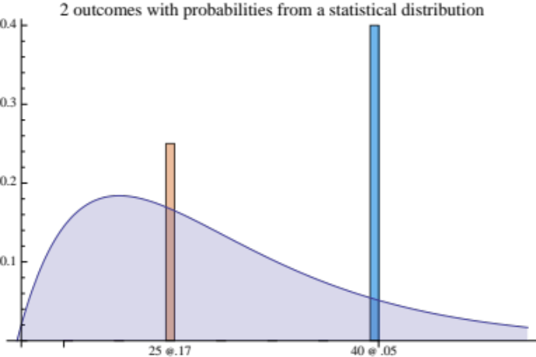
Expected return
If we have a number of uncertain outcomes then the probability weighted future value is what we should expect
Example:
Future value of $25 with probability 17%
Future value of $40 with probability 5%
Expected Future Value $25*0.17 + $40*.05
EFV = $6.25
Question: How come EFV less than $25?
Answer: All other outcomes have $0 Future Value

Slide 12
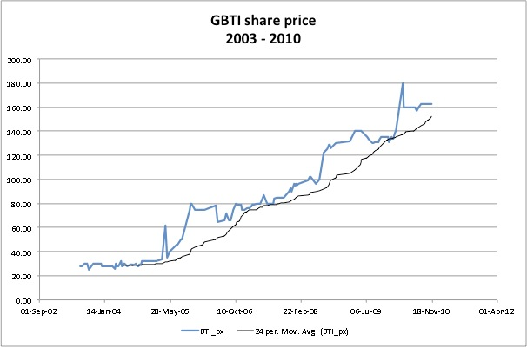
Stocks & Shares
Ownership of a ‘share (certificate)’ literally gives you a share of the value of a company
Companies raise money (equity) for their business by ‘issuing shares’
i.e. They sell a part of the company to investors in return for working capital
Companies return some of their profits to investors by ‘paying dividends’ to shareholders at regular intervals
Buying and selling of the shares of big companies is usually done in an organised way on an official stock exchange (the GASCI in Guyana)
If a company does well its share price rises over time
The market value of all outstanding shares is an important measure of a company’s worth
Notes:
Explain graph esp. trend line.
Contrast with randomness of stock price line

Slide 13
Options – simple derivatives
Suppose you like company A and want to buy shares in it but at some time in the future (maybe you don’t have enough cash right now)
What you need is an option (literally) to buy Company A’s shares
Calls
A ‘call option’ gives the holder the right but not the obligation to buy a share of the underlying company at a certain date for an agreed price set when the option is ‘struck’
Puts
A ‘put option’ gives the holder the right but not the obligation to sell a share of the underlying company at a certain date for an agreed price set when the option is ‘struck’
Specifications require…
Underlying company, expiry, strike price
Notes:
Remind audience that these are European exercise options.
Mention what American exercise options are

Slide 14
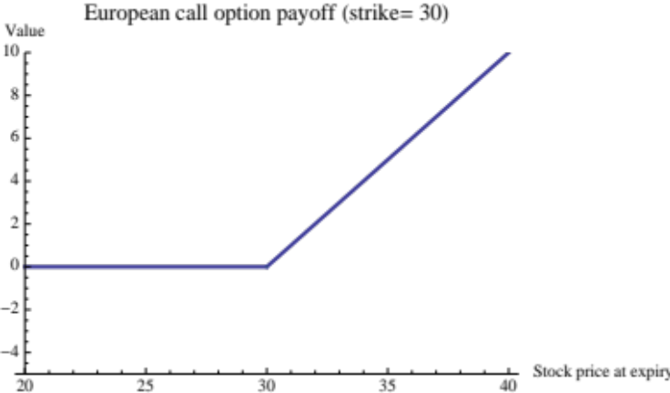
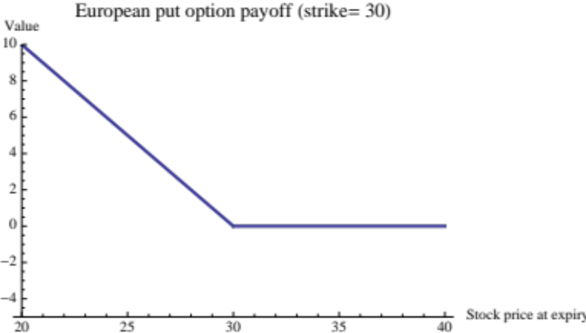


Payoff DIAGRAMS
Value of a call option at expiry (payoff) is shown at top, right
Call payoff = max{(price –strike), 0}
Put payoff is bottom, right
Put payoff = max{(strike – price), 0}
“Hockey stick” diagrams

Slide 15
Statistical derivation of call price
We know the payoff for a Call option so we know all future values of the option
but they all depend on the forward price of the underlying stock
If we can find out the probabilities of each possible forward price then we can use our expected return ideas to:
compute the Expected Future Value of the option,
discount the Expected Future Value back to today at the risk free rate,
to get the Call option price!
So, what about the forward prices of the underlying stock …?

Slide 16
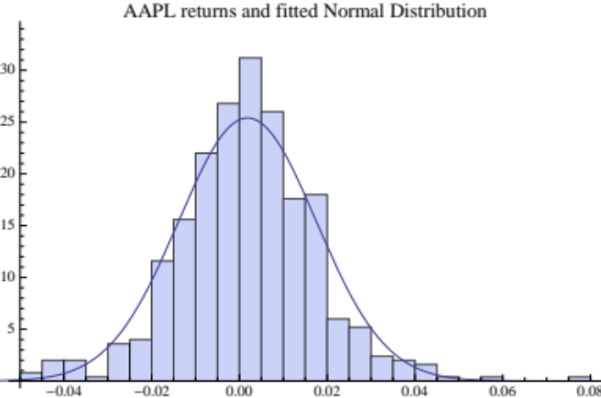

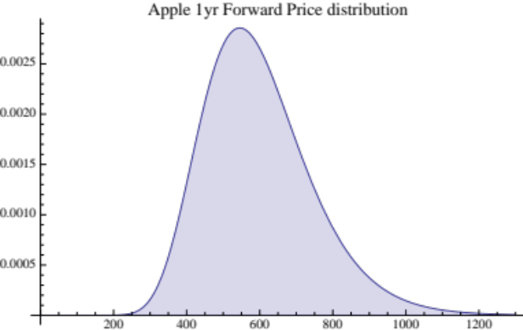
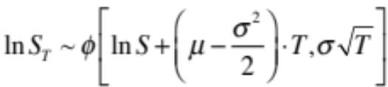
Forward Price statistics
The price return process equation
dW is a random draw from N(0,1) * Sqrt(t)
The forward price solution is
Forward prices have a lognormal distribution
The world of Stochastic Calculus
growth rate
volatility
return
time-step
random change
Notes:
Show how use lognormal price distribution pdf.
Use 400 px pt and 1000 px pt

Slide 17
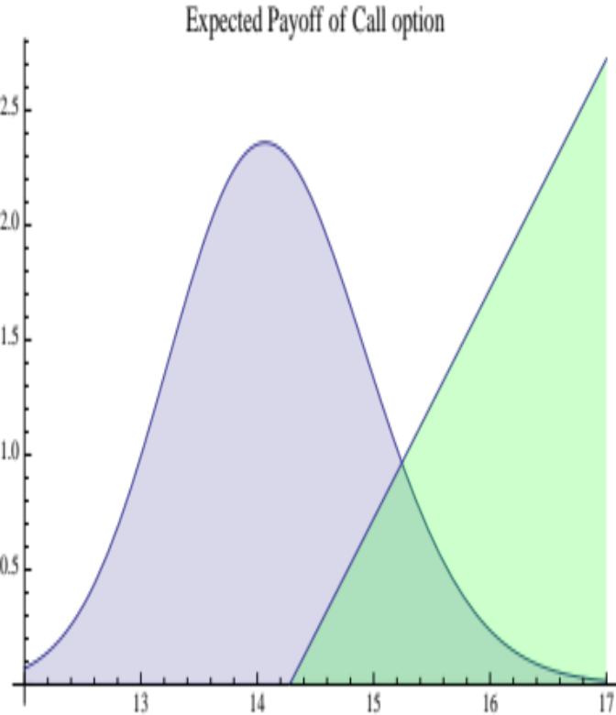
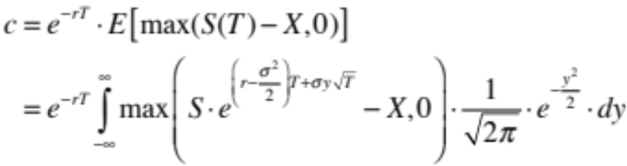
Call option value
Value of a call option is the discounted, expected payoff
(The present value of the doubly shaded area in the plot)

Slide 18
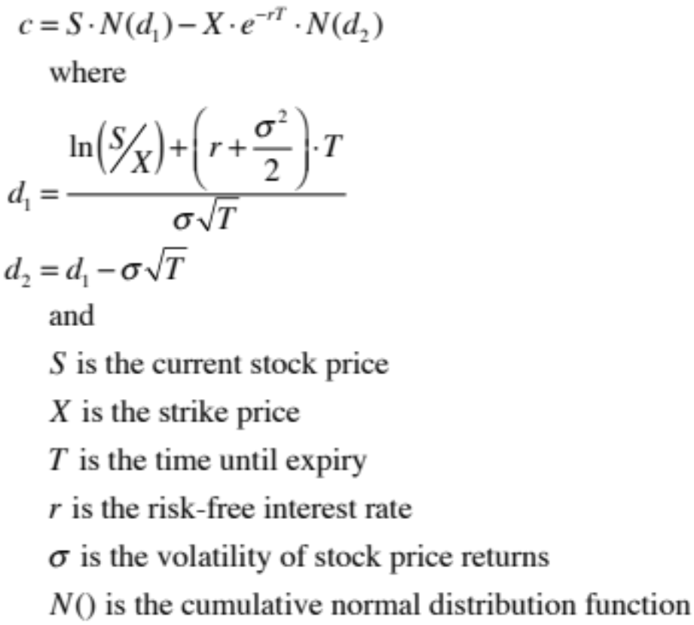
Black-Scholes formula

Slide 19
A one year, call option on dih
Banks DIH Limited’s shares trade on the GASCI with ticker “DIH”
Most actively traded stock since 2003
Price = 12.5 (18 Jul 2011)
What is the price of a 1 year, European, Call on DIH struck At The Money (i.e. Strike = current Price)?
S = 12.5
K = 12.5
T = 1 year
r = 3% (rate on GYD Treasury bills in 2011)
Volatility (σ) = 15% per annum (analysis of DIH price time series)
Dividend yield (d) = 4% (we haven’t discussed this but it matters)
Call Option price from Black-Scholes formula = 66¢
Leverage!
With Calls you can get ‘exposure’ to DIH for 66¢ as opposed to $12.50!

Slide 20
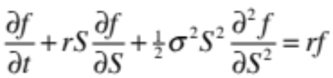
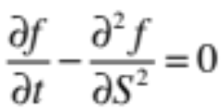
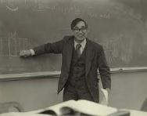
But …Why physicists in finance?
Call price formula is a solution of the Black-Scholes Equation
  Physicists familiar with the Heat Equation
  The Black-Scholes equation can be transformed into the Heat equation
  Many solutions (i.e. prices of different derivatives) known to Physics
Stochastic Calculus
The new maths!
Ito's Lemma and the mathematics of randomness

Slide 21
The Derivative Zo0
Pure vanilla Options (Call, Put, FRA)
    Low cost
    Leverage
American exercise
    Can exercise at anytime before expiry
Straddles / strangles
    Vanilla combinations that are sensitive to Volatility
Bull/Bear spreads
    Vanilla combinations that give up some upside (downside) in return for reduced cost
Barrier options
    Options that knock out if the stock price moves too much
Notes:
Role of leverage in the Global Financial Crisis

Slide 22
Philosophy!
The word "philosophy" comes from the Greek φιλοσοφία (philosophia), which literally means "love of wisdom”
”What Traders mean when they talk about things that they can’t figure out a way to make money from!”
Let’s leave mathematical details behind and discuss some general features of the world of Derivatives that Fischer Black, Myron Scholes and Robert Merton have bequeath

Slide 23
derivatives– The Good, …
Hedging & Insurance:
      Mr. Ragnauth’s rice sales and Forward Agreements
        Eliminate or ‘hedge’ FX risk
      Protective Puts
Flexible funding for industry:
      Callable bonds / Putable bonds
Risks and exposures:
      Derivative equivalents of complex financial structures in corporate assets allow correct evaluation and risk analysis

Slide 24
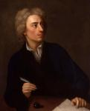
Derivatives– … and The Bad
‘Inventing’ derivatives to prove how clever you are:
    Double knock-out, geometric asian, cliquet …
Credit Derivatives and the “re-invention” of risk pricing
    Investment Banks as the “new, new” Insurance Companies
    Did Actuaries really not understand how to price risk?
    Contagion and the failure of hedging
From An Essay on Criticism, 1709, Alexander Pope
“A little learning is a dangerous thing;
drink deep, or taste not the Pierian spring:
there shallow draughts intoxicate the brain,
and drinking largely sobers us again”.

Slide 25
Quiz: what is black-scholes?
A theory in Finance describing how the future value of money changes
The names of two European professors who won the Nobel Prize in Economics
The names of two Jewish professors who developed a pricing formula for the value of options on stocks
A civil rights activist who opened access to the US banking system for Afro-Americans

Slide 26
Quiz: what is the expected return …
… of a $10 return with odds 3/10 and a $20 return with odds 7/10?
Very low
$17
$13
$20

Slide 27
Quiz: what is a european put option?
A financial asset that must be bought or ‘picked up’ before it has value
A right to buy a stock for an agreed price at a specified date in the future
A right to sell a stock for an agreed price at a specified date in the future
An obligation to sell a stock for an agreed price anytime before a specified date in the future

Slide 28

References & tools
Books
“Options, Futures and other Derivatives”, (7th Ed.), J. C. Hull, Prentice Hall, 2008
“Dynamic Asset Pricing Theory”, Darrell Duffie, Princeton University Press, 2001
“When Genius Failed: The rise and fall of Long Term Capital Management”, R. Lowenstein, Fourth Estate, 2002
“Liar’s Poker”, (reprint), Michael Lewis, W. W. Norton and Co., 2010
“Fool’s gold”, Gillian Tett, Abacus, 2010
Software:
R @ www.R-project.org
Mathematica @ www.wolfram.com/mathematica
Matlab @ www.mathworks.com/products/matlab/

