Slide 1
Maths, Money & Markowitz
A story of risk and return
by David Pollard
Notes:
What to do with the cash? A story of risk and return

Slide 2
Investment, the preliminaries
Before considering investments in financial instruments …
  Pay down debt
    Personal loans, credit cards etc.
    Loan rates often higher than average investment returns
  Mortgage under control
    … or paid off
    Mortgage rates are lower but loan sizes large and so are risks
  Remember
    Investments in markets really do go down as well as up
Notes:
Remember … it’s not a nansee story!

Slide 3
The investment problem
We have GYD $10M available for investment
Question: What to do with it?
  Deposit on the Bank
    Safe but do we get much interest?
  Under the mattress
    Less safe than a Bank
    Inflation will erode its value
      No interest being earned to compensate
  Buy stocks / companies
    Hot Tip
      Insider trading -- Beware!
    Fundamental analysis of corporate value from accounts
Take Quants’ approach to Investment

Slide 4
The guide slide
Markowitz and the Investment problem
Return and Risk
Market anatomy
Modern Portfolio Theory and the GASCI
More Philosophy!
    The ‘Haslyn Parris’ problem

Slide 5
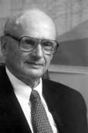
Harry markowitz
American Economist born 1927
University of Chicago B.A. (Physics, Philosophy), PhD (Economics)
Theory of portfolio selection under uncertainty, 1952
    Previous approaches hadn’t incorporated effects of risk
Developed theory identifying the optimal portfolio 1952 - 56
Nobel prize winner in Economics 1990

Slide 6
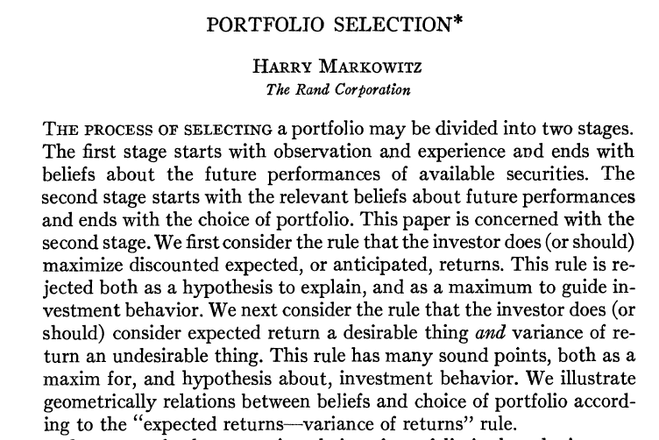
Markowitz’s insight
    Return is good…
    … but Risk is bad
    Must not only maximise Return but also minimise Risk
      Diversification of holdings amongst many assets can reduce risk
      Leads to mathematical optimisation
    The birth of Modern Portfolio Theory (MPT)
      Markowitz didn’t like the name, he claimed there was nothing particularly modern about it!

Slide 7
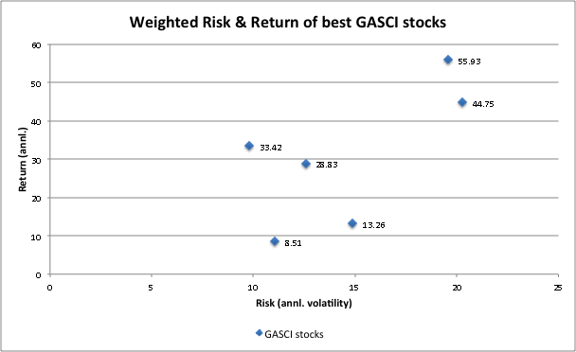
Risk & Return
Markowitz, higher returns lessrisk
Guyana Association of Securities Companies and Intermediaries Inc.

Slide 8
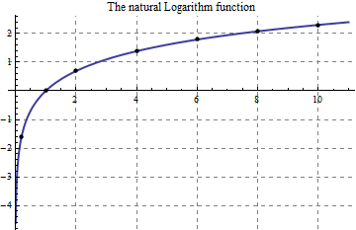

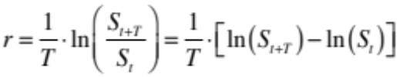
Returns
Total Return for Stocks & Shares has 2 contributions
  Price return
  Dividend income
  Focus on Price Return
  Let stock price at time t be S_{t}
  Remembering our Future Value formula we have
  So the continuously compounded return r is

Slide 9

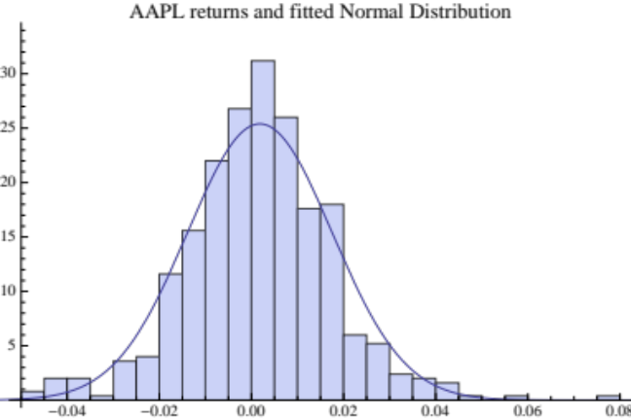
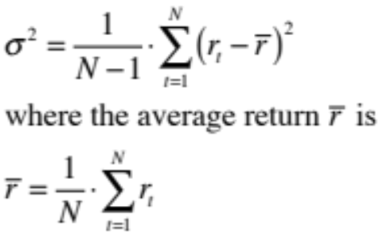
Volatility & risk
    We use Volatility to quantify Risk
      Remember volatility from Black-Scholes formula
    Daily, stock price returns are (almost) as likely to be positive as negative
    Volatility is
      Standard deviation of the (statistical) distribution of price returns
      A measure of the range of price return fluctuations
      Symbol is sigma σ
      Variance is volatility squared σ²
Volatility (σ) measures width

Slide 10
Computing Volatility
    A worked example (DIH, June 09)
    Number of returns (N) = 6
    Average Daily return = -0.002279
    Daily variance = 6.2e-5 = (Sum of last column)/(N-1)
    Daily volatility = SQRT(Daily variance) = 0.00787
    Annualised Volatility = SQRT(365)*Daily Volatility = 15%
Date | Price | Return | (R-Ravg)^2
25/05/09 | 11.0
01/06/09 | 10.0 | -0.01361 | .00013
08/06/09 | 10.8 | 0.01099 | .00018
15/06/09 | 10.7 | -0.00133 | 8.8e-7
22/06/09 | 10.5 | -0.00269 | 1.8e-7
29/06/09 | 10.3 | -0.00274 | 2.3e-7
08/07/09 | 10.0 | -0.00422 | 3.8e-6

Slide 11


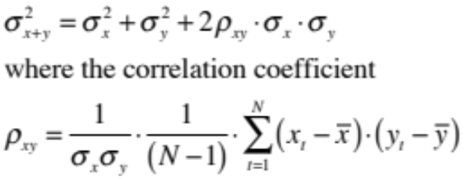
Benefits of Diversification
Suppose we hold 2 assets X and Y
Return at time t is
Average return is
What is the Variance of this 2-asset portfolio?
Correlation determines diversification
    For example if σ_{x} = σ_{y} and ρ_{xy} = -1 the portfolio is riskless!
‘Clever’ portfolio construction gives us a return without risk!

Slide 12
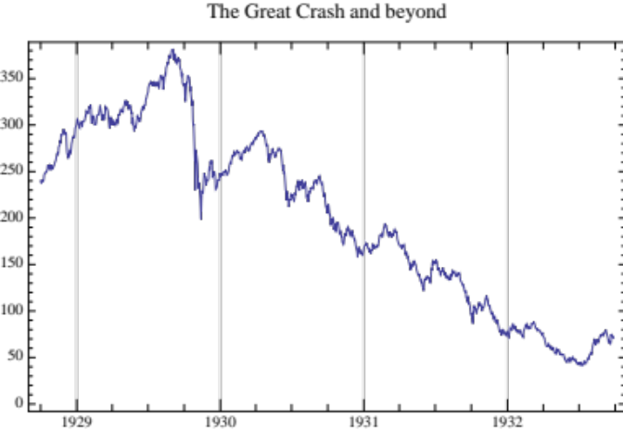
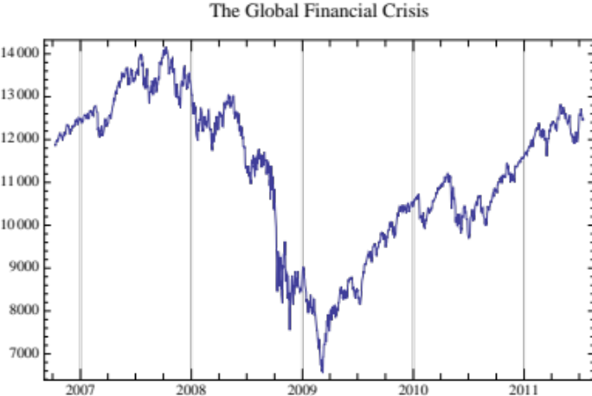
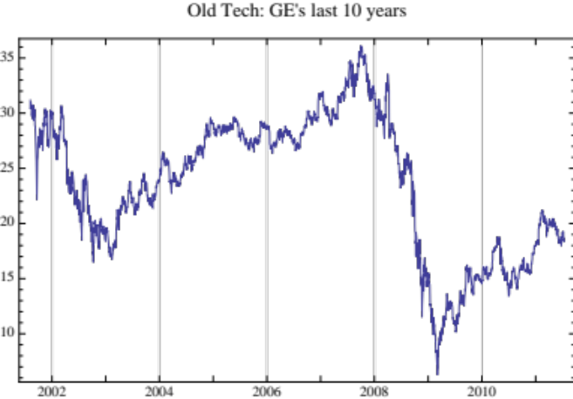
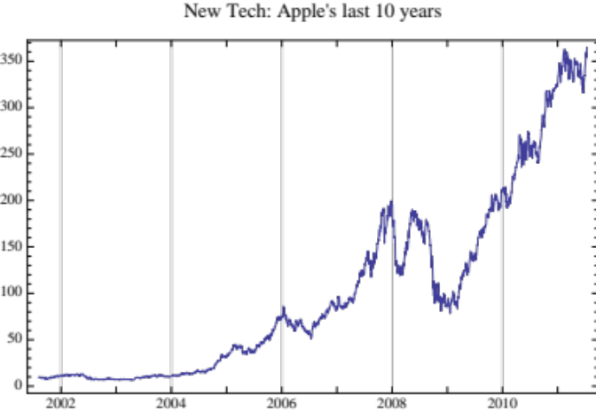
Stock price stories

Slide 13
Stock Exchanges
Major Equities are traded on Stock Exchanges
Buyer / Sellers
    Opposite views!
  The Market provides a mechanism to resolve opposing views
    viz. A way to find a price at which people who disagree can trade
Buyers place ‘Bids’ indicating willingness to buy at a specified price
Sellers place ‘Offers’ indicating willingness to sell at a specified price

Slide 14
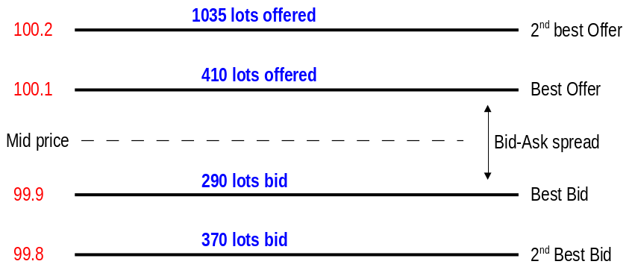
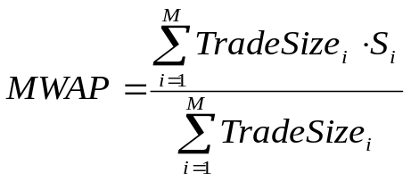
Order books
The ‘Spread’ = Best offer – Best Bid
    A measure of liquidity
The ‘Mid-price’ is the average of the Best offer and Best Bid
‘Last Trade Price’ is just what is says
The ‘Market Weighted Average Price’ is
    Average of (trade price) x (size of trade at that price)
    Also called (trade) Volume Weighted Average Price

Slide 15
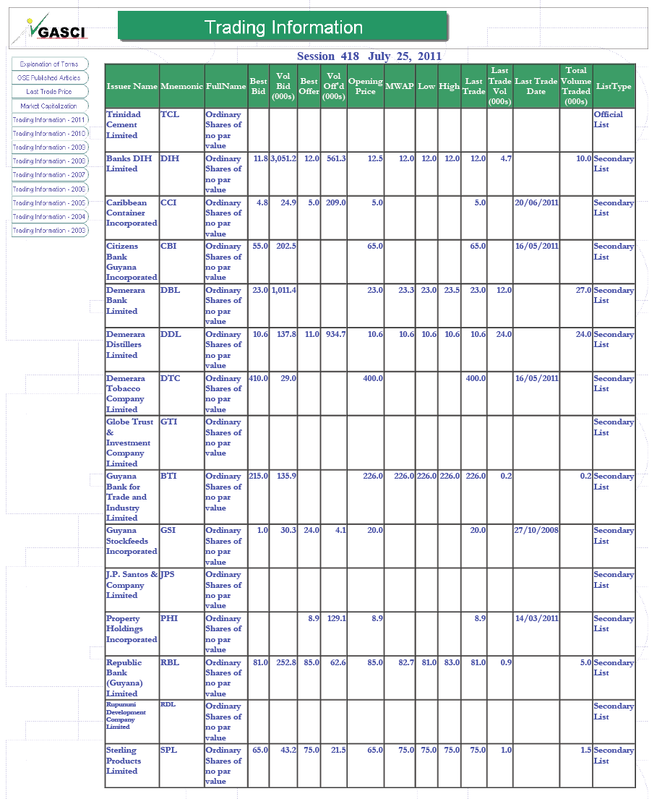
The gasci

Slide 16
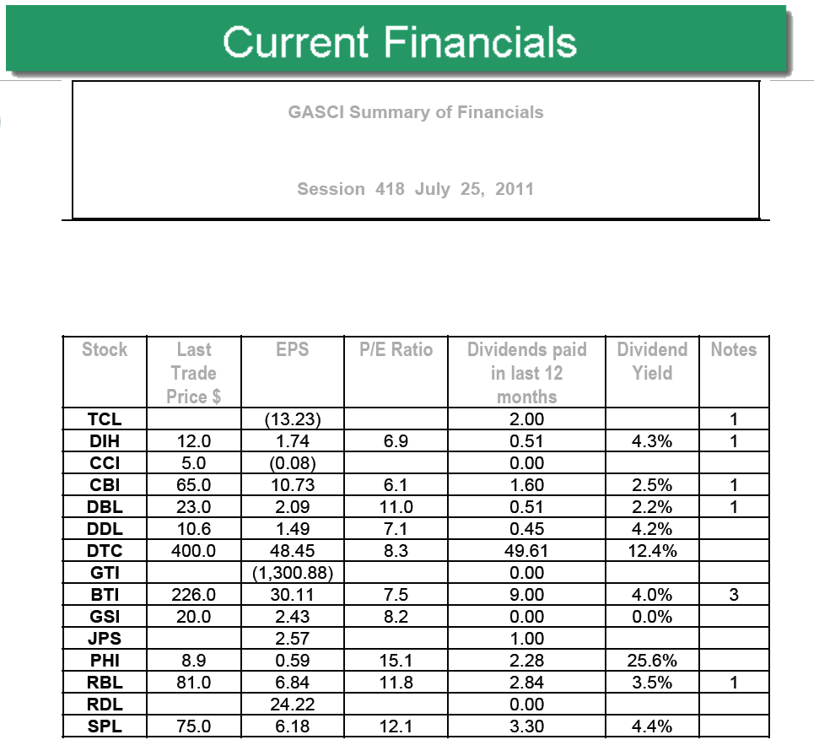
Gasci – Financials & dividends
Seven interesting stocks
    DIH, DBL, DDL, DTC, BTI, RBL, SPL

Slide 17
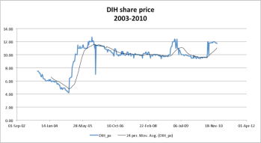
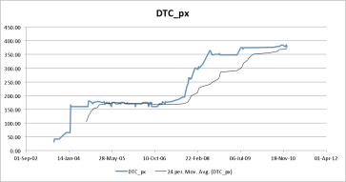
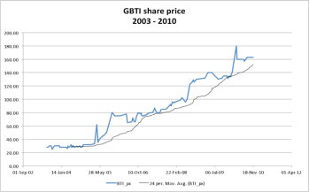
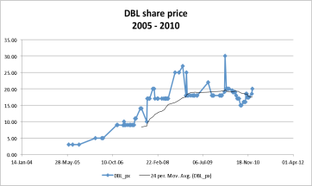
Gasci Stock price stories

Slide 18
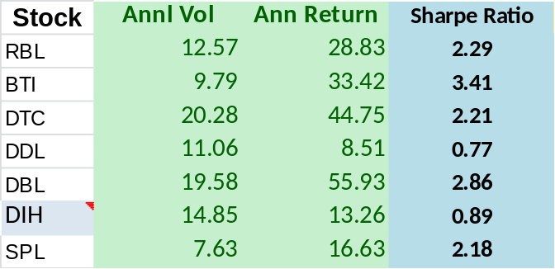
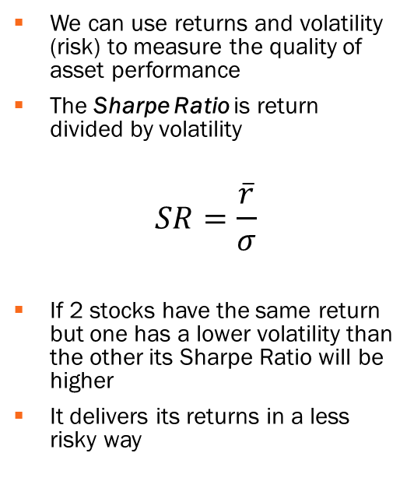
Sharpe ratio
We can use returns and volatility (risk) to measure the quality of asset performance
The Sharpe Ratio is return divided by volatility
$$SR=\frac{\overline{r}}{σ}$$
If 2 stocks have the same return but one has a lower volatility than the other its Sharpe Ratio will be higher
It delivers its returns in a less risky way
Some of these Sharpe’s are very high!

Slide 19
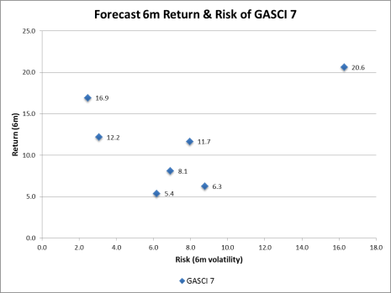
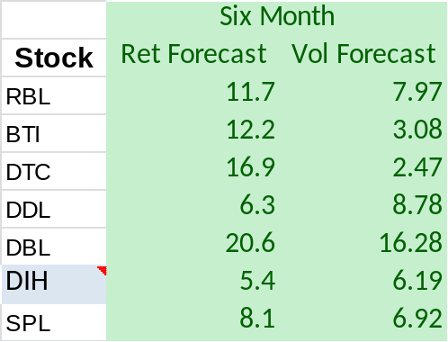
The GASCI seven
  DIH, DBL, DDL, DTC, BTI, RBL, SPL
  Features
    Financial & dividend information ✔
    Liquidity? (the GASCI 5)
    Analysts’ reports ✖

Slide 20

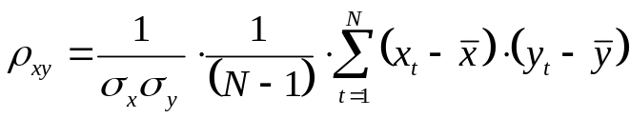
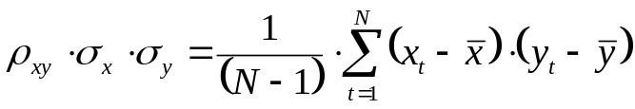
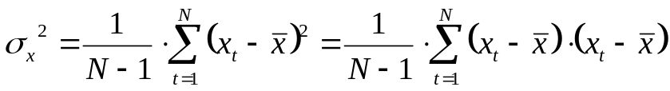
Covariance and correlation
Recall the correlation coefficient
Now notice that
The formula on the Right Hand Side is the Covariance of x and y
But also recall the Variance equation for x
So Covariance is the square of ‘something like’ a cross-asset volatility and …
Correlation is Covariance divided by the volatilities of the assets
The Correlation of an asset with itself = 1

Slide 21
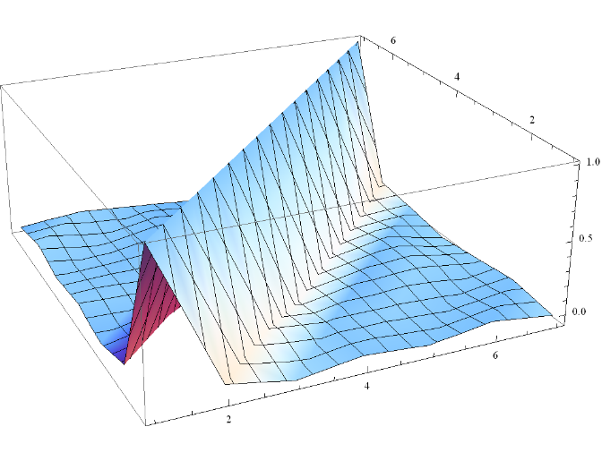
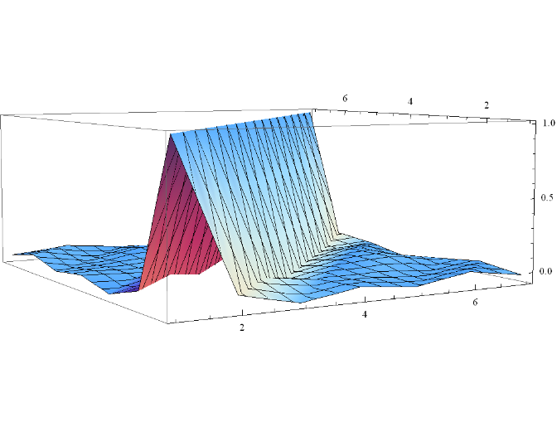
Correlation matrix: gasci 7
Very low cross-correlations show that stock prices move independently

Slide 22


Portfolio construction
Generalise our earlier 2 asset portfolio (X and Y) so that the weights of each asset need not be equal
Return at time t is now
Instead of
The mean portfolio return is
Variance of the portfolio is now
Choice of asset weights wx, wy sets balance between return and risk
We can use mathematical maximisation to find wx, wy that maximise the return for a specified level of risk (volatility)
    A point on the Efficient or Markowitz Frontier

Slide 23
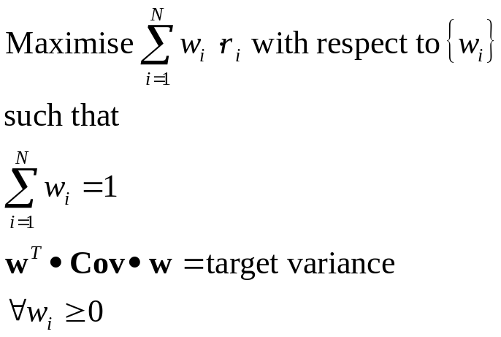
A frontier portfolio
The mathematical maximisation problem we must solve
The last condition ensures that we cannot ‘go short’
    Going ‘short’ allows us to benefit if the stock price falls!
    The GASCI is ‘long only'
Matrix notation

Slide 24
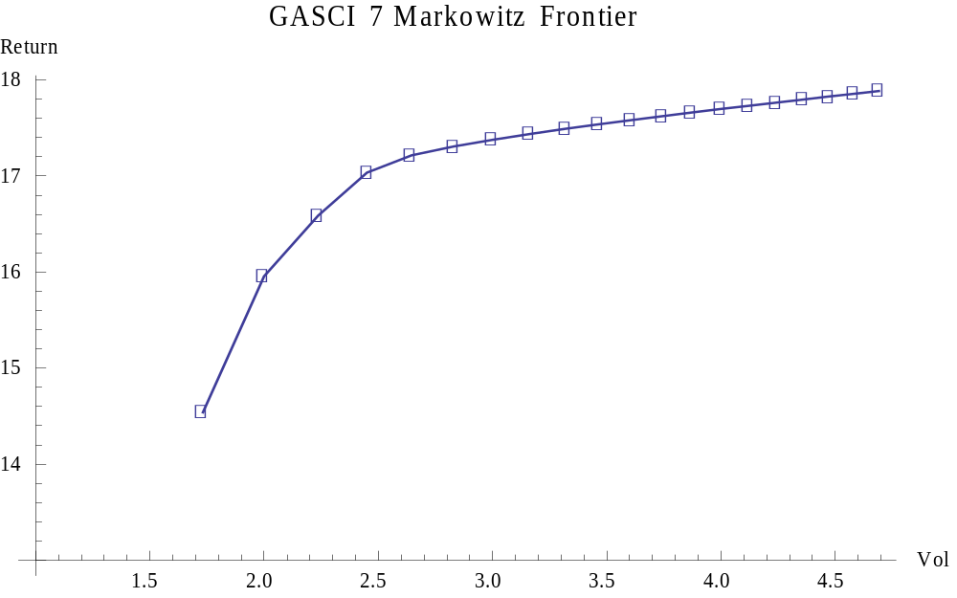
Gasci 7 Efficient Frontier
Stock | Weight
BTI | 0
DBL | 4%
DDL | 0
DIH | 0
DTC | 96%
RBL | 0
SPL | 0
Stock | Weight
BTI | 27%
DBL | 1%
DDL | 2%
DIH | 4%
DTC | 58%
RBL | 4%
SPL | 4%

Slide 25
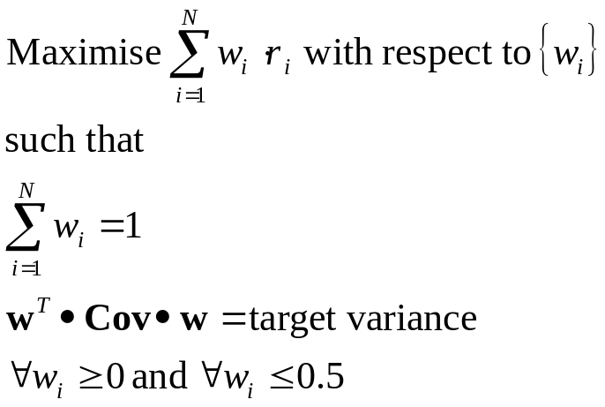
Portfolio with constraints
Suppose we don’t want any stock to have more than (say) 50% of funds
Then the maximisation problem has extra constraints on the weights
Such weight constraints can be particularised to target specific stocks

Slide 26
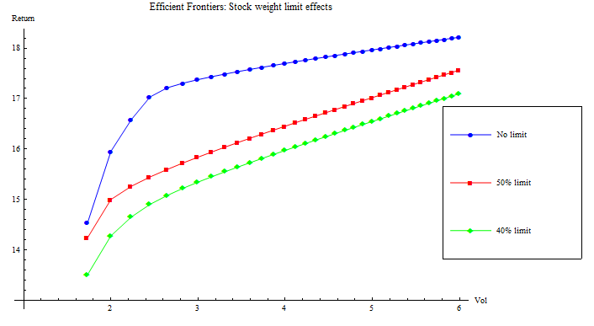
Efficient Frontiers with constraints
Stock | Weight
BTI | 40%
DBL | 2%
DDL | 3%
DIH | 5%
DTC | 40%
RBL | 5%
SPL | 5%

Slide 27
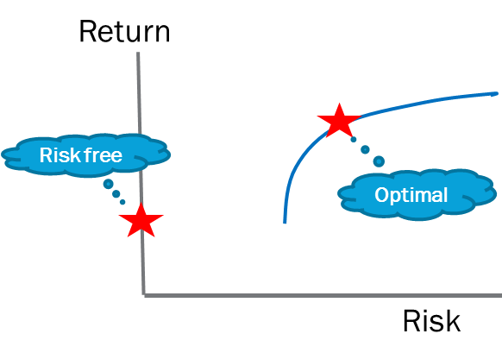
The Capital Allocation Line
Capital Allocation Space
Risks on x-axis, Returns on y-axis
We have the ‘frontier’ of efficient portfolios
We also have the Risk-free portfolio
    All funds in Treasury Bills
    So risk = 0
  Amongst Risky portfolios there is one that is optimal
    It must be on the Efficient Frontier!
  The Capital Allocation Line connects the Risk-free and optimal portfolios

Slide 28
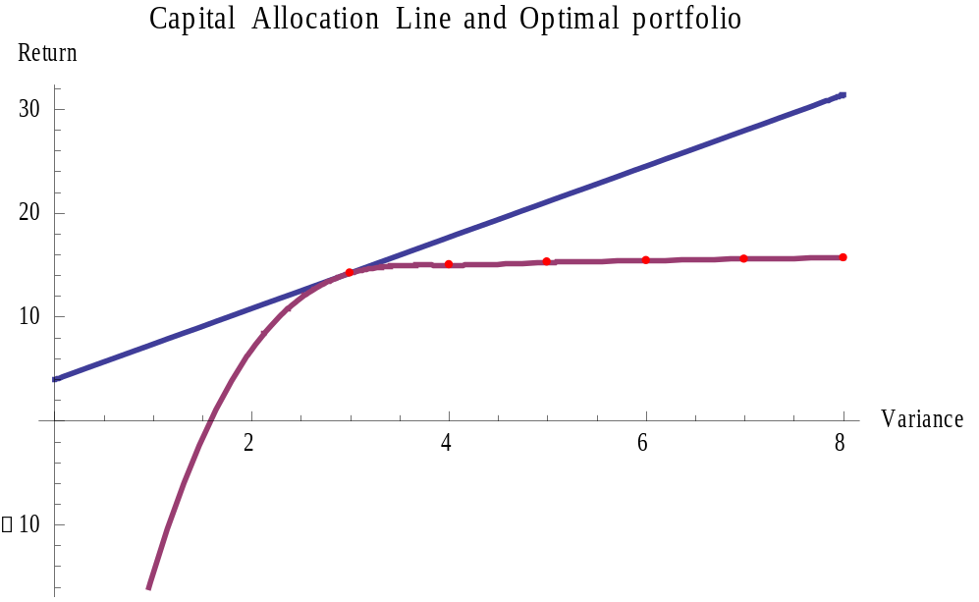
The gasci 7 portfolio
Stock | Weight
BTI | 33%
DBL | 2%
DDL | 2%
DIH | 4%
DTC | 50%
RBL | 4%
SPL | 5%
Return: 14%, Volatility: 1.7%!
50% stock constraint

Slide 29
From weights to shares
    What will we actually buy with our $10M?
Stock | Weight | $ value | Price | Shares
BTI | 33% | $3.3M | $163 | 20,245
DBL | 2% | $200K | $20 | 10,000
DDL | 2% | $200K | $10.2 | 19,608
DIH | 4% | $400K | $11.7 | 34,188
DTC | 50% | $5M | $378.1 | 13,224
RBL | 4% | $400K | $63 | 6,349
SPL | 5% | $500K | $65 | 7,692

Slide 30
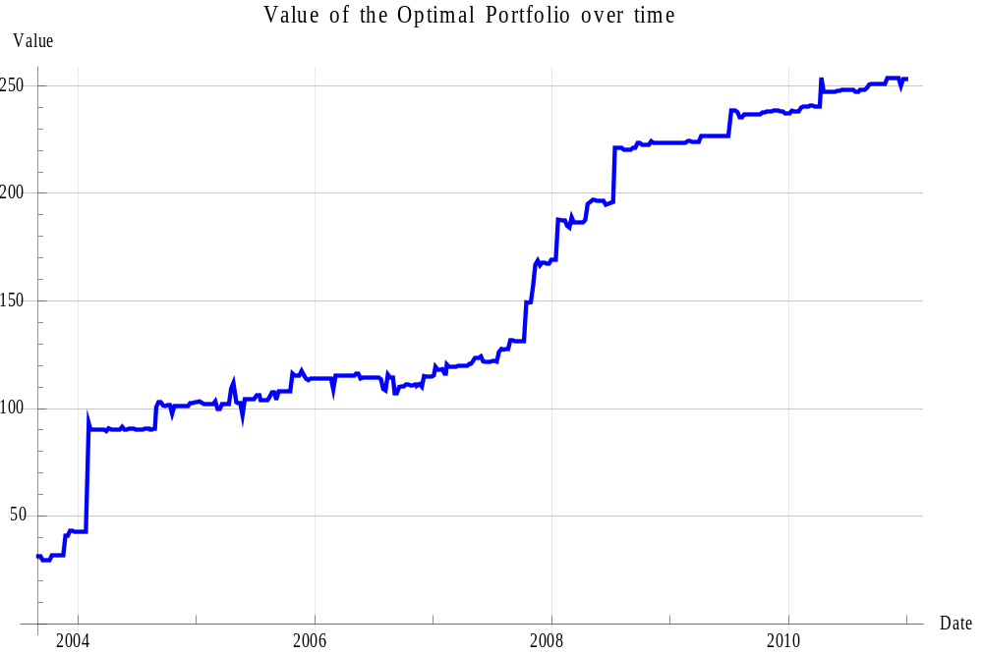

Optimal portfolio ‘backtest’
Higher ground
“Hindsight”
warning!

Slide 31
MPT method review
Forecast returns and volatilities of assets
Use mathematical optimisation to compute the efficient frontier
Determine the risk-free rate and then the capital allocation line
The optimal portfolio is the point of tangency with the efficient frontier

Slide 32
What kind of Maths is this?
We have used Modern Portfolio Theory to find optimal portfolios but …
What, no Stochastic Calculus?
    That’s right!
    (But see Dynamic Portfolio Theory)
Instead we have used
    Linear or Matrix Algebra to concisely represent the problem
    Numerical optimisation to find weights of efficient portfolios
    Interpolation to fit the Markowitz frontier
    Data Interpolation to do the Backtest
    Numerical root-finding to solve for the optimal portfolio
Notes:
I don’t want to come over all biblical but … what kind of maths is this?!

Slide 33
More Philosophy!
The ‘Haslyn Parris’ problem
    Ran State Planning in 70s/80s where his responsibilities included …
    How to set (asset) prices in a centrally planned economy?
    Use the Labour Theory of Value?
      Imagine the mathematical and operational difficulties!
      How to manage the information to balance supply and demand?
        Databases that would make Google blush!
      How to formulate and solve the mathematical price problem?
        Supercomputers that would make CRAY cry!
My view?
    Re-constructed Socialism requires delegated, effective, regulated markets to set prices and reduce resource mis-allocation
Notes:
Aunt Ada’s TED stockings as an element of demand

Slide 34
Quiz: What is the gasci?
The Guyanese Association of Security Companies and Intermediaries
The Guyana Association of Securities Companies and Intermediaries Inc.
Guyanese Against Serious Crime and Infidelity
The name of the second biggest exchange after the KOSPI in South Korea

Slide 35
Quiz: what is the daily volatility …
… of the following sequence of daily returns: {-2.0, 0.0, +2.0}
2.0 * SQRT(365)
0.0
2.0
4.0

Slide 36
Quiz: what step is not used in mpt?
Forecast the returns and volatilities of assets
Use mathematical optimisation to compute the efficient frontier
Determine the risk-free rate and then the capital allocation line
Weight each asset by the cube of its Sharpe Ratio in the optimal portfolio

Slide 37

References & tools
Books
“Econometric Analysis”, (7th Ed.), W. H. Greene, Prentice Hall, 2011
“Principles of Corporate Finance”, (7th Ed.), R. Brealey, S. Myers, F. Allen, McGraw-Hill, 2010
Software:
Mathematica @ www.wolfram.com/mathematica
Matlab @ www.mathworks.com/products/matlab/

